Slide 1
Quick and Dirty Ansible
October 16, 2019
Irfan Khan – SE (F5 Networks)

Slide 2
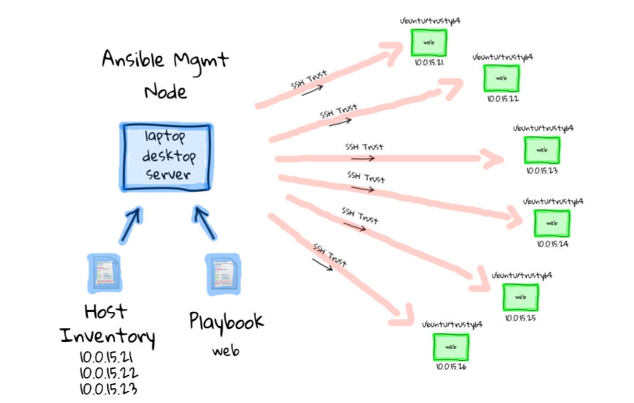
Ansible
Notes:
It is important to understand the used cases of Ansible and different components within the Automation framework. In order to use Ansible you need Ansible installed on a host machine. Ansible installation is simple and well documented on Ansible website. Ansible can be installed on bunch of Linux subsystems. For this example you have a bunch of webservers which needs to be provisioned. The task is to install apache webservers on all the webservers. The webservers are the target machines. The host machine needs to have SSH access to these target machines. You will need to create a inventory host file which consist the list target system. You will also needs to create a playbook which will have one or multiple tasks. In this case you will have task to install webserver on the target host.

Slide 3
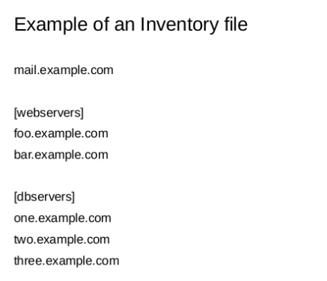
Inventory file
Notes:
Inventory host files can use IP address or FQDNs. It can be a flat simple list or can be organized based on different criteria’s. In this example shown we have organized different sets of inventories for webservers another for DB servers, You can have one play running against webservers another against DB servers.

Slide 4
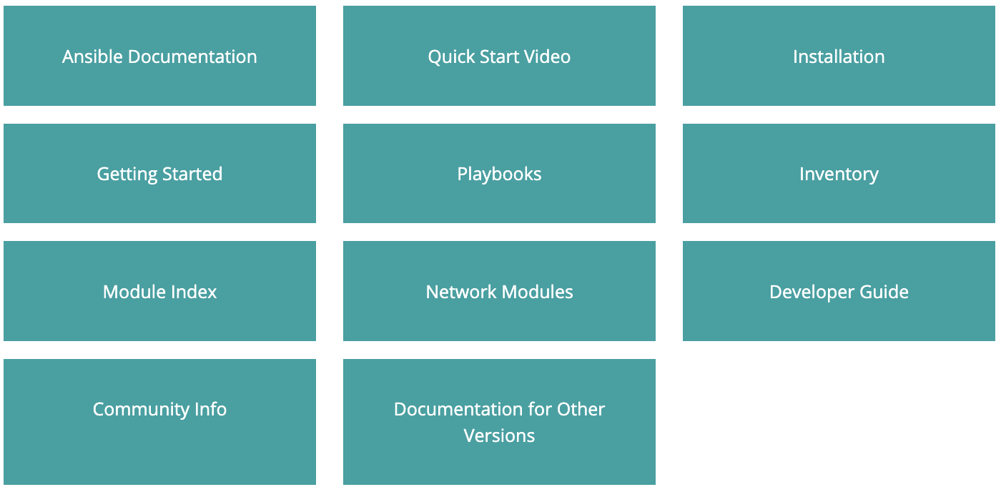
Ansible Resources
http://docs.ansible.com
Notes:
Ansible website is a great source or documentation, The link to the website is http://docs.ansible.com. Click on Installation tab to learn how to install Ansible. Click on Inventory to learn about how to create inventory host files for your used case. You can Click on Ansible documentation for guide on how to write your first playbook.
The most important section is module index.

Slide 5
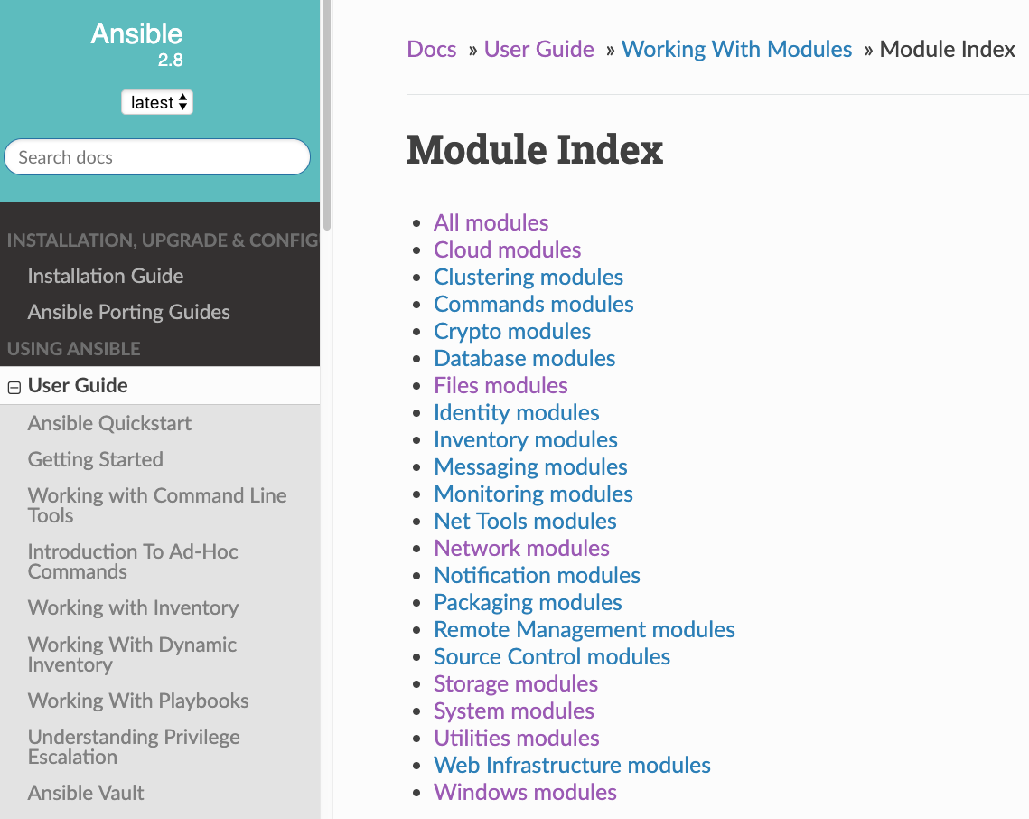
Understanding Module
To perform tasks such as installing a package, restarting a service, or copying a configuration file.
Documentation for each module is available on ansible.com or ansible-doc command
Notes:
The Ansible playbooks can consist or one more multiple tasks. Each task corresponds to a module. If you want to install a linux application there is corresponding module available. If you want to create a task to create a virtual server on a BIG IP there is a module available for that, To get a list and syntax of all available module you can Click in the Module Index of the Ansible website, There modules are downloaded and installed when you install Ansible on the host machine, These module list gets updated with every new release of Ansible.

Slide 6
F5 vs Competitors
A10 - 4 modules
Avi - 60+ modules
Citrix - 15 modules
Radware - 3 modules
F5 150+ modules
Notes:
F5 has consistently been updating the module list over time. Since F5 VE’s are supported on all major clouds it is important for us to highlight our work in this regard. Virtualization and Automation goes hand it hand. You can configure and provision entire BIG-IP config using Ansible today.

Slide 7

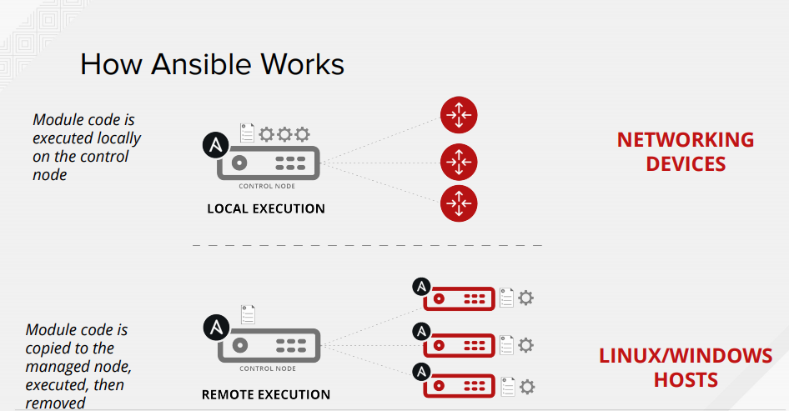


How Ansible Works
Notes:
Since F5 is a network device the F5 BIGIP Ansible playbook is executed on the local Ansible hosts. The local host after execution send an API call to the BIG IP to provision the desired changes.

Slide 8
Playbook
name: play 1 name
host: inventory host or group 1
tasks:
playbook
A playbook can contain one or more plays. A play is a collection of tasks that need to be performed on a host or group of hosts
play 1
name: task 1 name
…
play 2
List of tasks
name: task 2 name
…
play 3
List of plays
play N
Notes:
The Playbook can have one or many tasks. When the playbook is run it is executed in the sequential order from Top to Bottom. You can also call or run certain play by using the tag function. It is a good habit to use tags for each play of your playbooks. It help in troubleshooting,

Slide 9
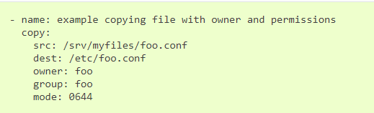
Module
ping - Try to connect to host, verify a usable python and return pong on success (this is not network ping)
command - Executes a command on a remote node
setup - Gathers facts about remote hosts
copy - Copies files to remote locations

Slide 10
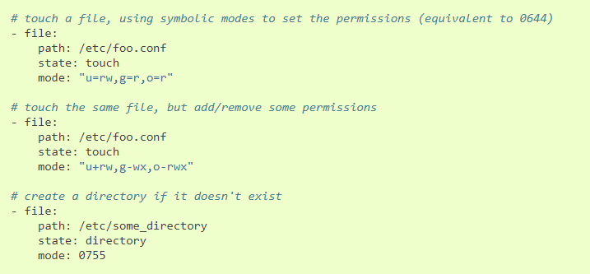
Module
file - Sets attributes of files or create directory

Slide 11
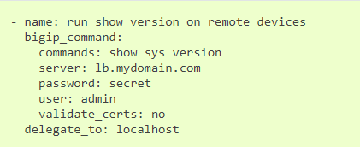
Network module
bigip_command - Run arbitrary command on F5 devices
server: REST host
user: REST user
password: REST password
delegate_to: localhost is to make task run locally which then talks HTTP to remote host

Slide 12
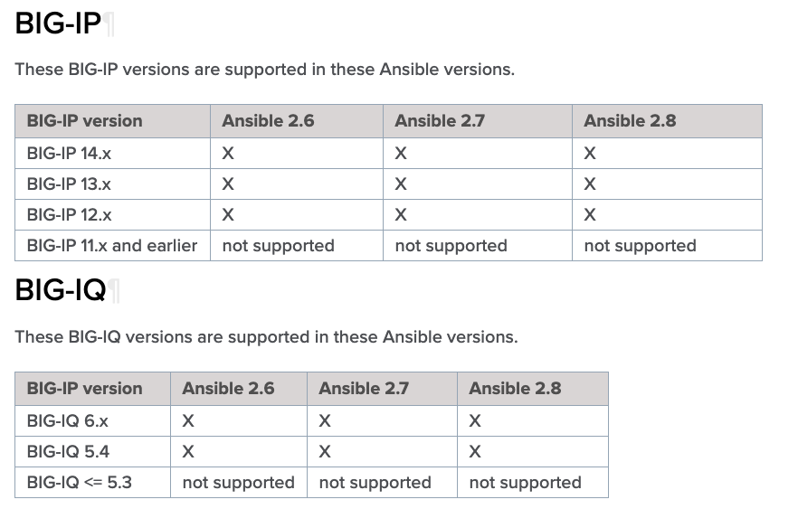
Releases and Versioning

Slide 13
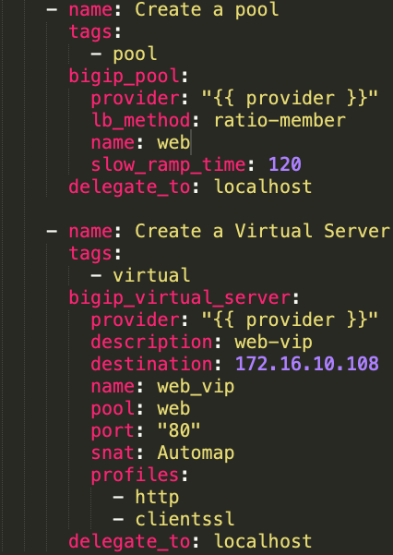
Network module
bigip_pool - Manages F5 BIG-IP LTM pools
bigip_virtual_server modules manages virtual servers
server: REST host
user: REST user
password: REST password
delegate_to: localhost is to make task run locally which then talks HTTP to remote host

Slide 14
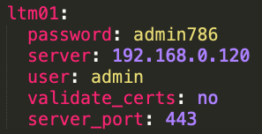
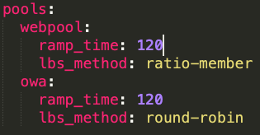
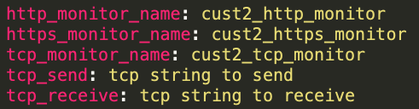
Variable - YAML format
Lists or Sequences
Dictionaries or Mappings Variables
http://www.yamllint.com/
YAML Syntax Checker

Slide 15
YAML
Start of file
---
Ansible will not complain if forgotten
End of file
…
Ansible will not complain if forgotten
Comment
#
String
YAML strings do not have to be quoted, although you can quote them if you prefer. Even if there are spaces, you do not need to quote them.
Boolean
True, False
Yes, No

Slide 16
Variable
The simplest way to define variables is to put a vars section in your playbook with the names and values of variables.
vars:
key_file: /etc/nginx/ssl/nginx.key
cert_file: /etc/nginx/ssl/nginx.crt
conf_file: /etc/nginx/sites-available/default
server_name: localhost

Slide 17
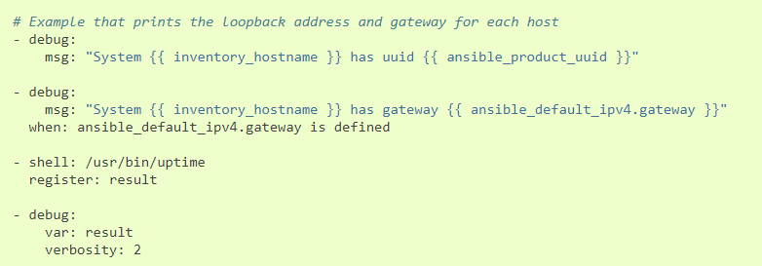
Troubleshooting
Debug module - Print statements during execution
Verbose
Add -vvvv flag to see more details
# ansible <inventory host or group> -m <module> -a <module’s arg> -vvvv
# ./<playbook file> -vvvv

Slide 18
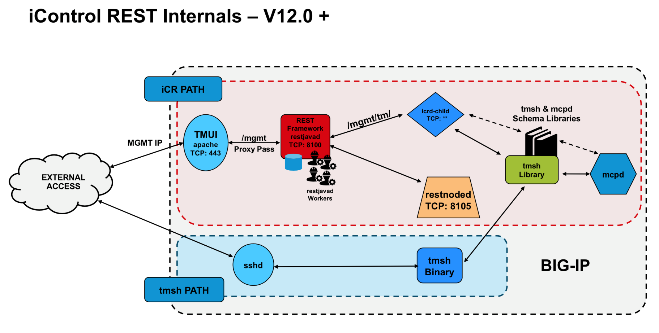
Troubleshooting
To see REST request/response, you can capture unencrypted packet on BIG-IP port 8100
# tcpdump -nni lo -s0 -w /var/tmp/<output file> port 8100 -v

Slide 19
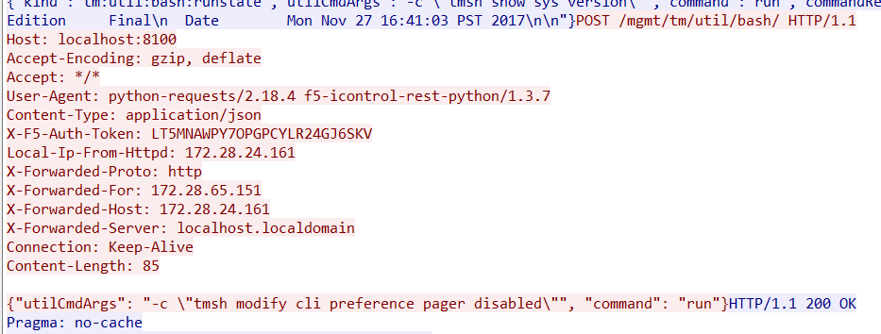
Troubleshooting
# ansible bigip -c local -m bigip_command -a 'commands="show sys version" server="{{ inventory_hostname }}" user=admin password=admin validate_certs=no'
REST request

Slide 20
Thank You

